Slide 1
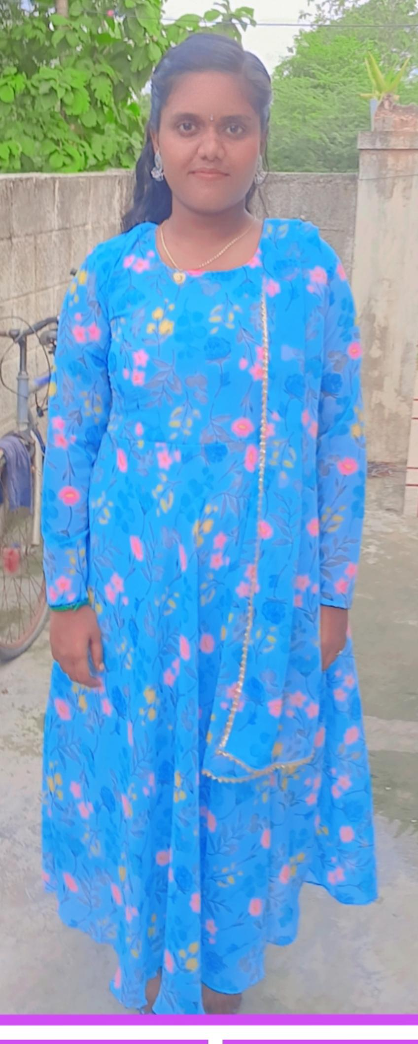
MY PORTFOLIO
HELLO EVERYONE
THIS IS PAVITHRA

Slide 2
ABOUT ME
👤 Name: Pavithra. P 🎓 Education: B. SC Computer Science 2024-2027, Vidhya Sagar Women’s College, Chengalpattu. 📍 Location: Guduvancherry, Thamil Nadu. 💡 Career Goal: To become a Government Officer

Slide 3
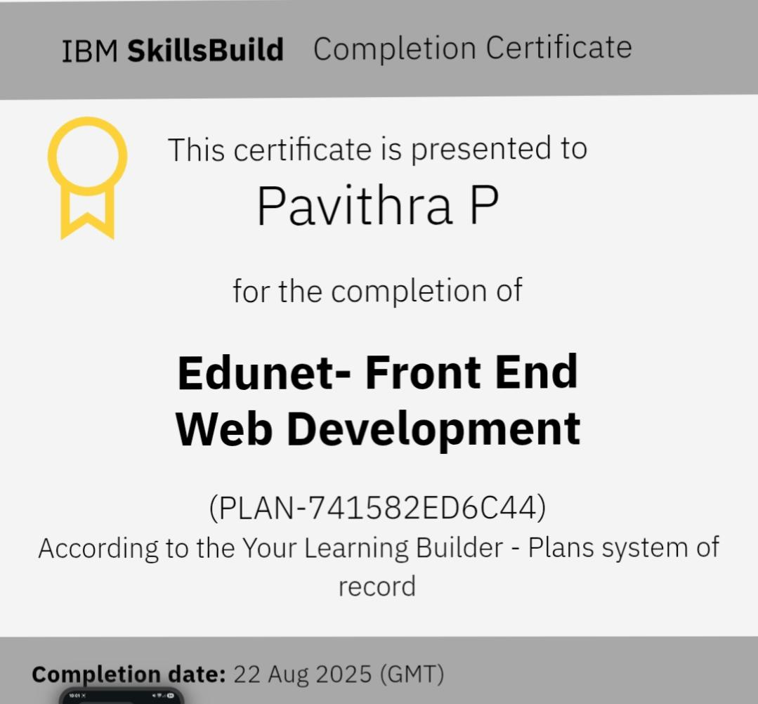
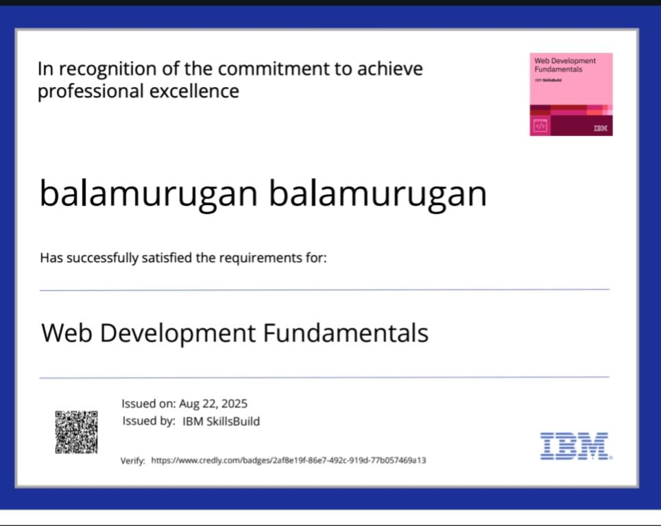
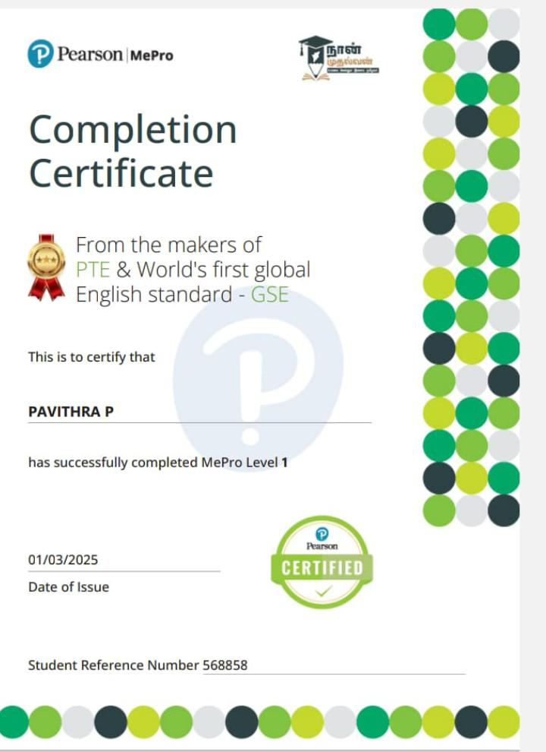
MY SKILLS
CONTACT : 8668109829
EMAIL ID: pavithraabitha029@gmail.com

